Slide 1

Movie Market Analysis
BY GROUP 3

Slide 2
Group members
Ibrahim Salim
Abond Mwangi
Abigail Muthenya
Nelson Kamau

Slide 3
OUTLINE
Business Problem
Data
Objectives
Results
Conclusions
Limitations

Slide 4
BUSINESS PROBLEM
In an effort to diversify and remain competitive, the company is planning on launching a new movie production studio to join the growing trend of original content creation.
The company however currently lacks expertise in the film industry and is uncertain about which types of movies to produce.
To ensure a successful market entry, the leadership needs data-driven insights to guide investment decisions.

Slide 5
The primary goal of this analysis is to answer key questions such as:
Which genres are the most profitable?
What release months or seasons yield the best box office results?
Does a director play a key role in the success/profitability the films?
How does the production studio influence a movie's financial and overall success?
Are there trends over time in audience preferences or industry performance?

Slide 6
DATA
The data that was used to provide insight for the project included:
Box Office Mojo.
IMDB.
Rotten Tomatoes.
TheMovieDB.
The Numbers.
The data had various info on movies including: genres, directors, gross income, release dates, and popularity etc.

Slide 7
OBJECTIVES
This project main objectives include:
Perform exploratory data analysis (EDA) to identify trends and patterns in the film industry.
Visualize the film data .
Highlight key factors contributing to the financial and critical success of films.
Provide data-driven recommendations to ensure a safe and profitable entry into the industry.

Slide 8
RESULTS

Slide 9
STUDIO VS BOX OFFICE.
We began first with looking into the studio vs box office grossing incomes.
This comparison would show us if there is a significant difference in performance of movies according to the studio which produced it showing that there are actual factors that lead to high performance of movies.
We began first with top 5 studios according to the box office performance

Slide 10
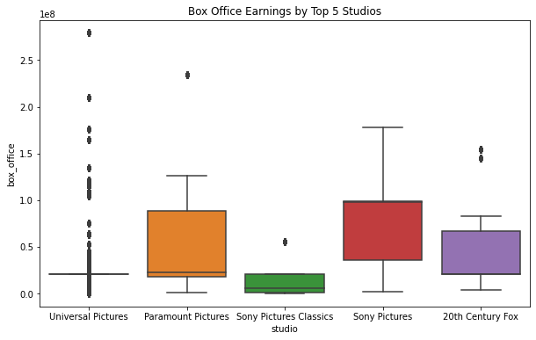
The top 5 list gave us the following studios as seen on the boxplots shown on the graph on the right.
We can see that there is a visible difference in the distribution of the box office earnings of each of the top 5 studios according to no of movies produced.

Slide 11
This then led to a test to check if there was a significance in the performance of the studios:
The test came back positive which suggests that the studio does play a role in determining box office success, and there is a meaningful difference in how the studios perform.

Slide 12
Conclusion
There is a significant difference in box office performance between the studios. This means that some studios are performing significantly better than others at the box office.
The studio behind a movie seems to play an important role in its box office success. Therefore, the studio factor is a major determinant of a film's financial performance.

Slide 13
TOP DIRECTORS VS BOX OFFICE
For this test we were looking into the various directors for movies.
First we looked into the top movies according to ratings which was the performance check then we looked into the directors of these movies.
Comparing this info with box office earnings as the metric and whether a movie had a top director or not to see if there was a correlation.

Slide 14
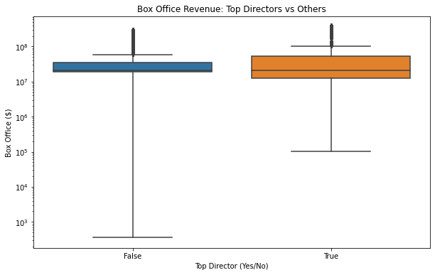
The graph here was created to check on the box office performance of the top directors in accordance of ratings.
So the false is movies without top directors and true was movies with top directors.
Both groups had similar median earnings, but top directors showed a higher and more consistent performance.
The top directors group had fewer low-performing films, indicated by a smaller lower range.
Top directors also had more high-grossing outliers, suggesting a stronger potential to produce blockbuster movies.

Slide 15
We also conducted a samples t-test, to check for significance .
The null hypothesis for this test was that the mean box office revenue for movies by top directors is the same as that of movies by non-top directors.
The test results were positive therefore we can confidently conclude that the box office earnings for movies directed by top directors are significantly higher than those directed by others.

Slide 16
GENRE VS BOX OFFICE
We analyzed the top 10 most common genres to see if genre influences box office success.
A box plot showed visible differences in revenue distribution across genres, with some genres displaying higher outliers and wider spreads.
A one-way ANOVA test was conducted to statistically test the differences.

Slide 17
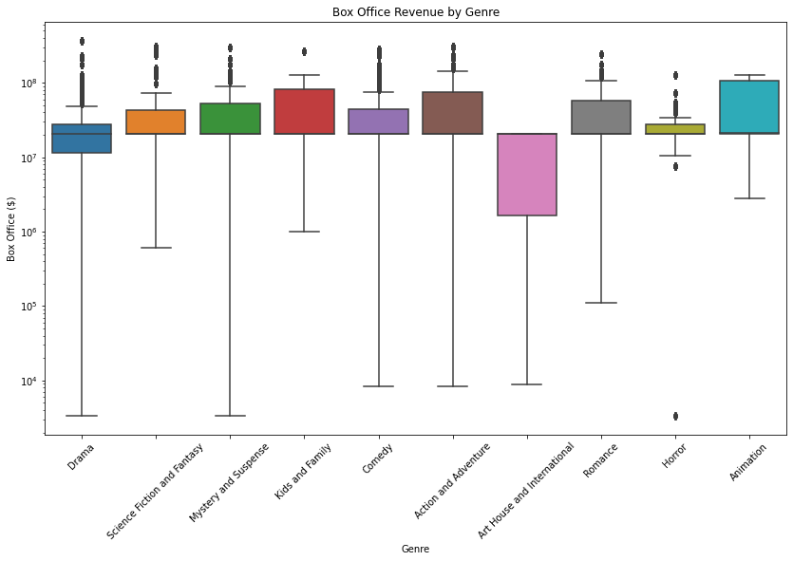
According to the graph on the left we deduced that:
This is the spread for the top 10 best performing genre according to box office.
There is a clear significant variability in spread, and recurring outliers across the nine groups.
Box office revenue varies widely by genre; some genres show more consistent or higher returns than others.

Slide 18
In addition we performed a one-way ANOVA test on the box office revenues across the top 10 genres:
We did this to check there a statistically significant difference in the mean box office revenue between the top 10 genres.
This test compares the means of all 10 genre groups to determine if at least one genre has a significantly different average box office performance.

Slide 19
The test yielded a high F-statistic (651.84) and a p-value of < 0.001.
Interpretation: We reject the null hypothesis - at least one genre has a significantly different average box office revenue.
This suggests that genre selection is a key factor in box office success.

Slide 20
GENRE VS RELEASE DATE
After getting the top 10 genres according to box office performance we looked into the release date and wanted to analyze our data with the date in mind.
First we found the mode which is the most common month that our top 10 genres are released.
This will give some info on the best month to release the specific genre that we have on our top genre list.

Slide 21
From our top genres the most common month to release the movies were analysed to be this below:
Animation December
Comedy January
Drama October
Western June
From this we looked into a hypothesis test to check if the month where a movie is released is related to its genre.
For this since both were categorical data meaning the release month and the genre we are going to use a Chi-Square Test of Independence

Slide 22
The output was positive therefore:
Interpretation: There is a significant relationship between movie genre and release month.
This suggests studios may strategically release certain genres during specific months to ensure and also bolster box office performance.

Slide 23
CONCLUSIONS

Slide 24
TOP DIRECTORS.
Invest in Top Directors to Boost Revenue Potential is a conclusion drawn from the directors vs gross income
The test comparing films directed by "top directors" versus others showed a statistically significant difference in box office earnings. This suggests that audiences may be more likely to attend films associated with well-known or critically acclaimed directors.
Studios should aim to build long-term relationships with top directors or emerging directors who show consistent box office performance.

Slide 25
STUDIO PERFORMANCE
Model After High-Performing Studios that wer identified in the test above.
Test showed that there was significant difference in studio performances.
Among the top five studios analyzed, Universal Pictures and Sony Pictures produced films with the highest revenue potential. A new studio could analyze their portfolios, production budgets, and content strategies to learn how to replicate success.
Partnering with or hiring experienced executives from these studios could also be advantageous.

Slide 26
GENRE Performance
Prioritize Animation and Action/Adventure genres when choosing films to produce.
The analysis revealed that films in the Animation and Action and Adventure genres consistently achieved the highest median and upper-quartile box office returns.
Animation, in particular, showed tightly clustered high-performing results with relatively fewer low outliers.

Slide 27
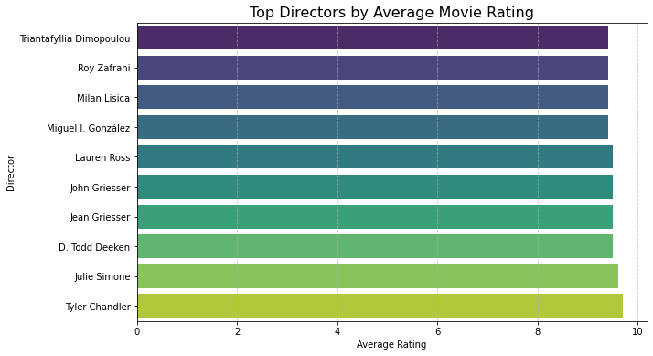
For director purposes we compiled a list of top directors according to box office performance that would be favourable to boost performance

Slide 28
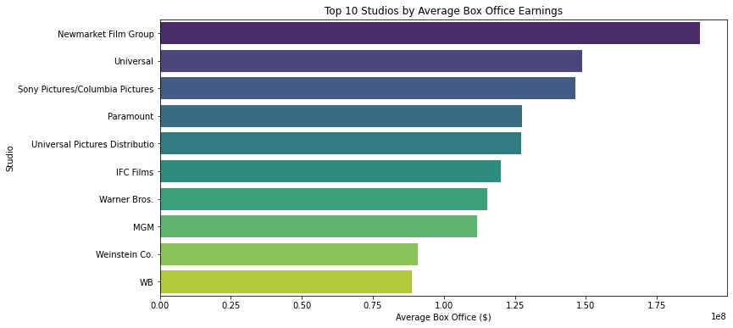
For studios that performed well we compiled a list of the top 10 studios according to international box office gross income to aid in future collaboration.

Slide 29
LIMITATIONS.

Slide 30
Limited Scope of Variables: The dataset does not include several critical variables that affect box office success, such as marketing spend, release timing (e.g., holiday vs. off-season), actor popularity, or franchise value.
Assumption of Independence and Normality: Statistical tests such as t-tests and ANOVA assume normally distributed data and independence between groups, assumptions that may not hold perfectly given the large variance and potential clustering in the film industry.
Missing Audience Demographics: There's no information on who watched the movies—age, gender, region, etc. This limits your ability to analyze trends by target audience or identify underserved markets.

Slide 31
END.

